Slide 1
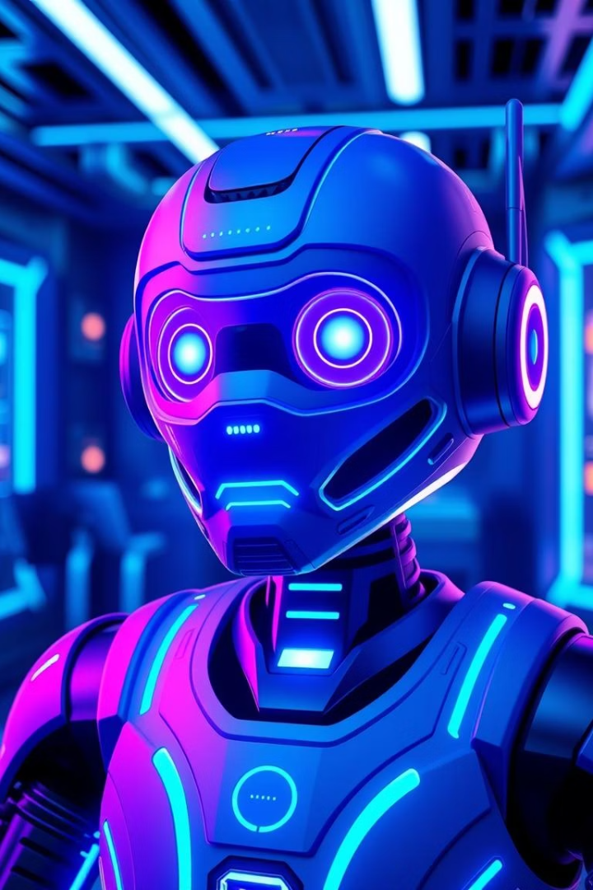
DeepThink AI Chatbot Project Presentation
Presented by Sarthak Gupta
Guided By Uttam Deshmukh
Ajeenkya DY Patil University, Pune

Slide 2
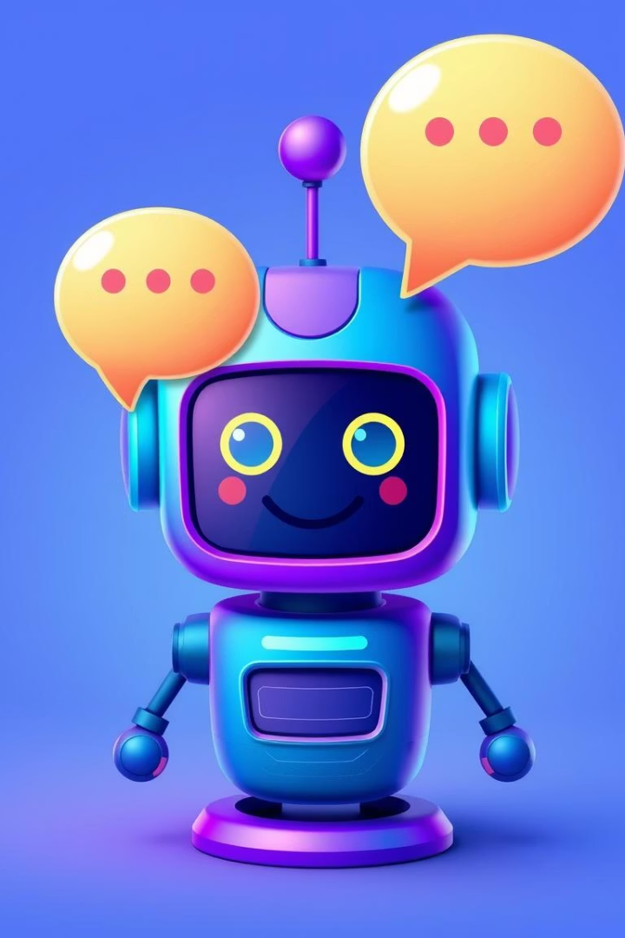
Introduction to DeepThink AI Chatbot
What is it?
AI-powered chatbot with intelligent, context-aware replies
Purpose
Provide instant, user-friendly, accurate conversational responses

Slide 3
Challenges with Current Chatbot Systems
Existing Types
Common Problems
Rule-Based
Limited interaction depth
Retrieval-Based
Static, repetitive responses
Context-Aware
Context loss over conversation
AI-Powered

Slide 4

Proposed DeepThink AI System
Advanced Conversational AI
Admin Control
Scalability
Configurable system settings
Supports increasing user base seamlessly
Context maintenance across sessions

Slide 5
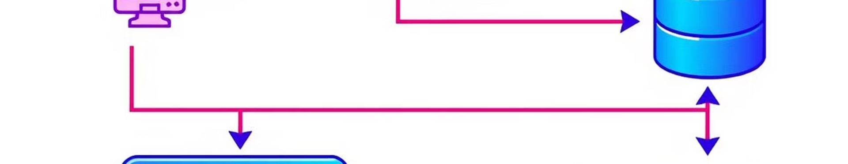
System Architecture & Modules
Core Modules
User Interaction
NLP Processing
Admin Control
Error Handling

Slide 6
Technology Stack Overview
Frontend
Backend & NLP
React
Node.js
Vite
Express
Tailwind CSS
Google AI Studio NLP
MUI
Hosting: Netlify

Slide 7
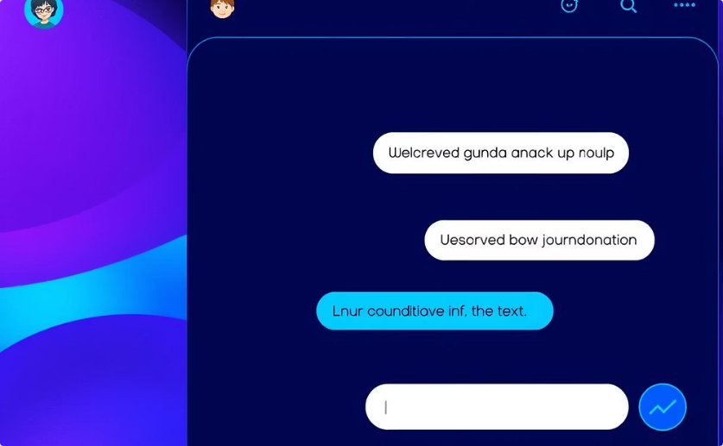
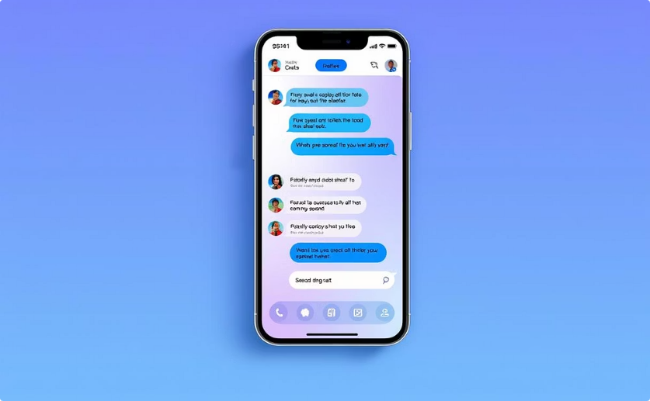
DeepThink User Interface Screenshots
Main Chat Screen
Responsive Layout

Slide 8

Limitations & Future Enhancements
Current Limitations
Internet dependency
No contextual memory
Missing user authentication
Future Enhancements
Contextual memory support
Voice interaction
Multi-language capabilities

Slide 9

Conclusion
Robust System
Scalable Design
User Friendly
Efficient NLP-driven user interaction
Supports growing user base smoothly
Simple, responsive interface

Slide 10
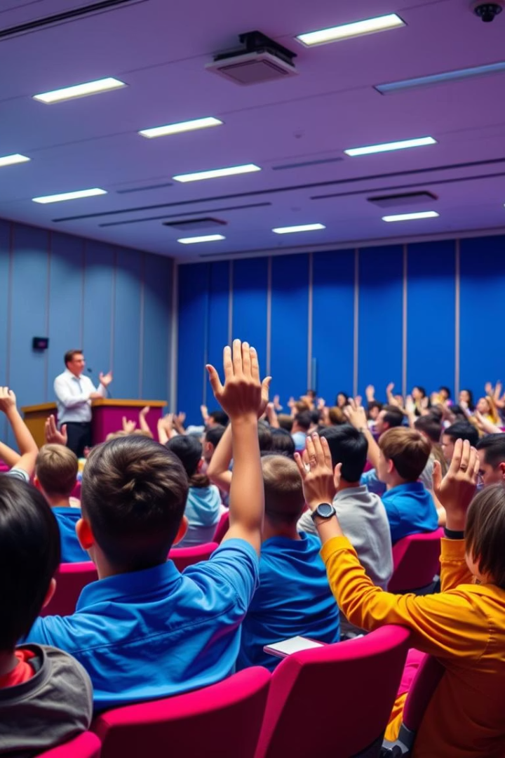
Thank You & Questions
Contact: sarthak576.github.io/myportfolio
Please feel free to ask your questions.

